Slide 1


Disaster Preparedness and Response App
This presentation explores the features and benefits of a comprehensive Disaster Preparedness and Response App, designed to empower individuals and communities in the face of emergencies.

Slide 2

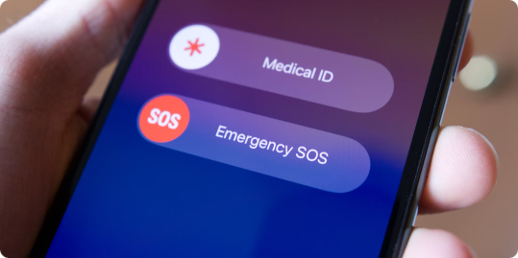
Key Features of the App
1
Real-time Alerts
2
Personalized Risk Assessment
Receive instant notifications about approaching disasters, including earthquakes, floods, and wildfires.
Get tailored information based on your location and specific vulnerabilities.
3
Emergency Contacts
4
Preparedness Checklists
Store contact information for family, friends, and emergency services.
Access comprehensive checklists and guides for assembling emergency kits and preparing for potential disasters.

Slide 3


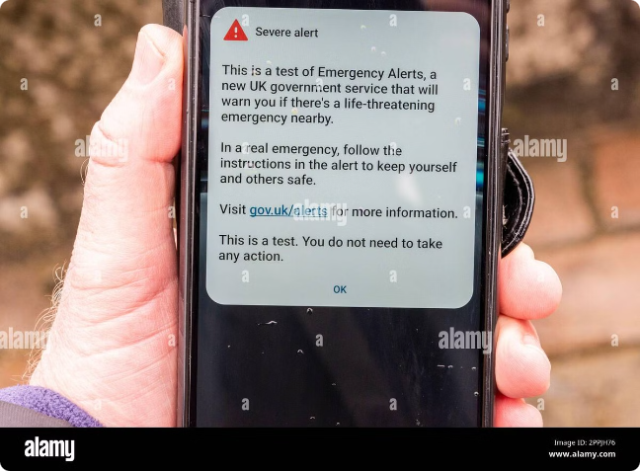


Real-time Disaster Alerts and Notifications
Early Warning Systems
Integrates with official disaster warning systems to provide timely and accurate alerts.
Geolocation Tracking
Uses GPS to pinpoint your location and send relevant alerts based on proximity to danger.
Multiple Communication Channels
Provides alerts through push notifications, SMS, and email.

Slide 4

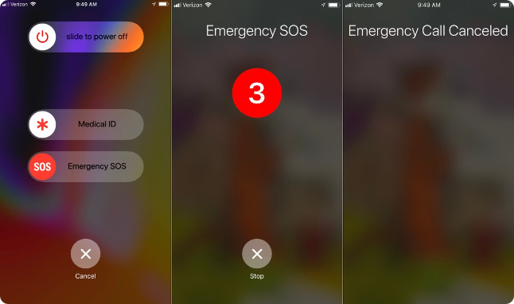
Emergency Contact Information and Hotlines
Emergency Services
Contact Numbers
Police
911
Fire Department
911
Ambulance
911
National Disaster Hotline
1-800-424-8853

Slide 5

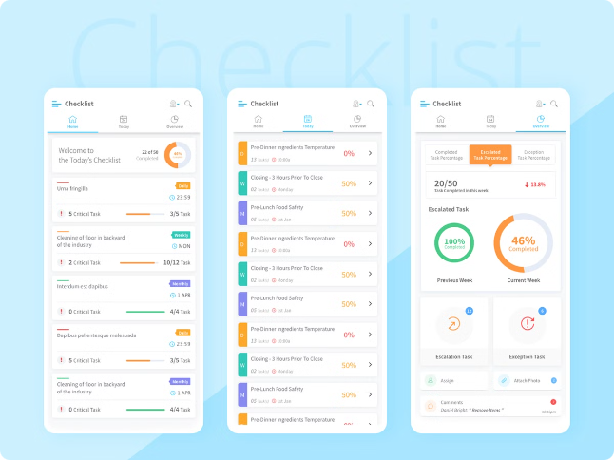
Disaster Preparedness Checklists and Guides
Emergency Kit Essentials
Disaster-Specific Guides
Provides detailed instructions on assembling an emergency kit with food, water, first aid supplies, and other necessary items.
Offers tailored preparedness information for different types of disasters, such as hurricanes, earthquakes, and floods.
Safety Procedures
Includes instructions on evacuation procedures, shelter-in-place guidelines, and other critical safety measures.

Slide 6
Crowdsourcing and Community Engagement
Real-time Situation Reports
Community Forums
Volunteer Management
Allows users to share real-time information about their location, safety, and needs during a disaster.
Provides a platform for residents to communicate with each other, share resources, and coordinate assistance efforts.
Connects volunteers with organizations and individuals in need, facilitating a coordinated response to emergencies.

Slide 7


Integrated Mapping and Geolocation Services
1
Disaster Zones
Displays real-time maps of affected areas, including evacuation routes and shelter locations.
2
Resource Availability
Shows the locations of available resources, such as medical facilities, food banks, and emergency shelters.
3
User Location Tracking
Allows users to track their own location and share it with family and friends.

Slide 8

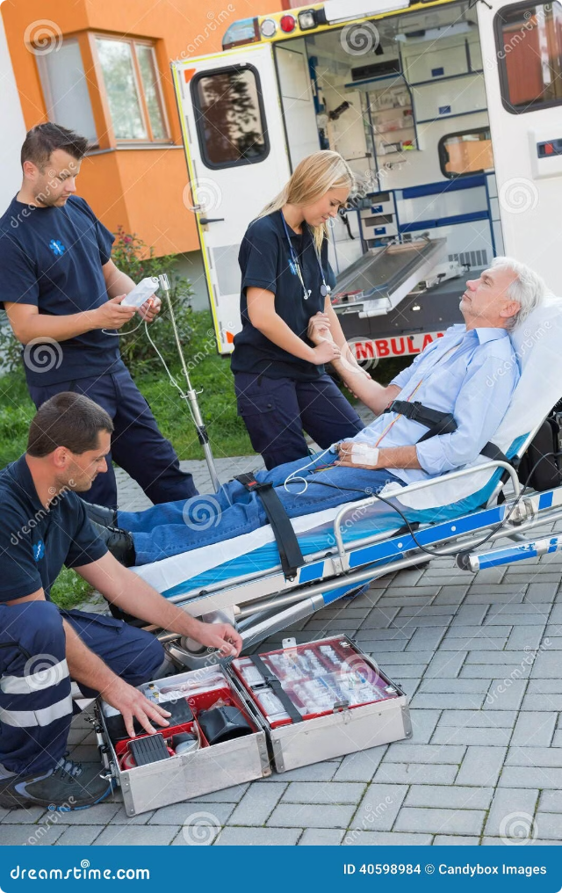




Post-Disaster Recovery and Assistance
Medical Support
Shelter and Housing
Connects users with medical professionals and resources, facilitating post-disaster health services.
Provides information on available shelters, temporary housing options, and recovery assistance programs.
Financial Assistance
Community Support
Links users with organizations and government agencies providing financial aid for disaster recovery.
Facilitates connections between individuals and community groups offering emotional support, counseling, and other forms of assistance.

Slide 9
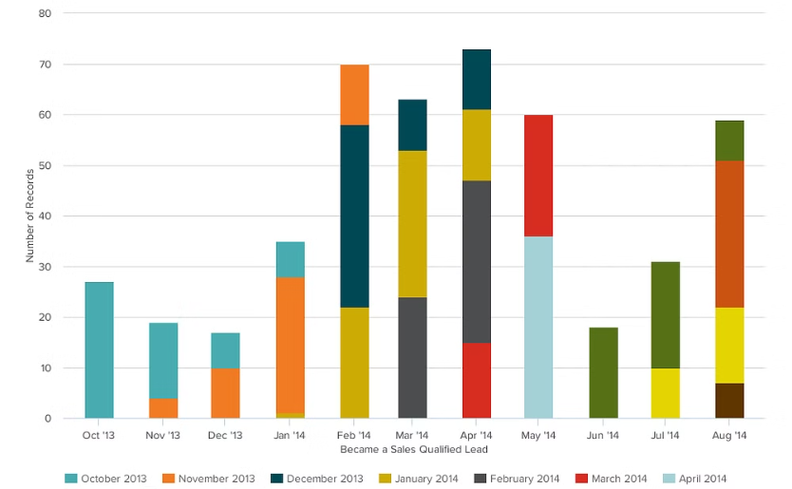

Data Analytics and Predictive Modeling
Historical Data Analysis
Real-time Data Integration
Leverages historical data on past disasters to identify patterns and predict potential risks.
Integrates data from various sources, including weather forecasts, seismic activity, and social media feeds, to provide comprehensive insights.

Slide 10


Conclusion and Future Enhancements
The Disaster Preparedness and Response App offers a comprehensive solution for enhancing community resilience and minimizing the impact of disasters. Future enhancements will include expanded language support, integration with wearable technology, and advanced artificial intelligence capabilities for personalized risk assessment and disaster response.

